Slide 1
Code Profiling Workshop
Tier-2 HPC User Day 2025

Slide 2
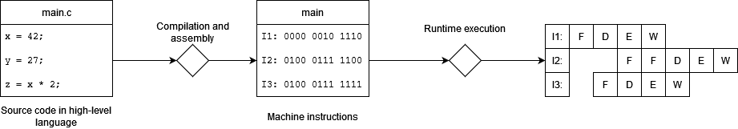
The role of a code profiler in code optimization
Large gap between high-level code and processor execution
Compiler transforms code into machine instructions
Processors executes instructions pipelined and out-of-order
Profiler bridges hardware utilization and source code

Slide 3
The role of a code profiler in code optimization
Profiling helps you understand code performance characteristics by collecting hardware performance counters
identify hotspots and bottlenecks
provide memory, I/O, accelerator usage statistics
analyze MPI communication and other parallel approaches

Slide 4
Success stories
Laser ablation code in C (mechanical engineering)
Calls to GSL routines gave a lot overhead => simpler, pure C fitting gave a 4x speedup
Nested loop structure was bottleneck => code transformations and microarchitecture optimizations gave another 4x speedup

Slide 5
Success stories
SP-Wind: Navier-Stokes solver in Fortran+MPI
Strided memory access caused cache thrashing => reordering loops gives 2x speedup in specific case
Inter-node communication bottleneck in large-scale runs => rethinking domain decomposition gives 30% speedup

Slide 6
Agenda
Introduction to and overview of profilers
Examples using Linaro MAP
Serial CPU code
MPI parallel CPU code
CUDA GPU code

Slide 7
Tracing vs sampling
Tracing
Insert function calls for counters
Generally, requires code changes (instrumenting can be automated)
Can produce detailed and accurate results
Can introduce overhead and output can be overwhelming
Good for in-depth analysis (if you know the code)
Sampling
Statistical average of snapshots
Requires compilation with debug symbols (-g option)
Might lack details or be inaccurate, especially for very short runs
Usually small overhead, easy to interpret (with a good profiler)
Get a quick overview without knowledge of the code

Slide 8
The HPC profiler landscape
TAU Performance System® is a portable profiling and tracing toolkit for performance analysis of parallel programs written in Fortran, C, C++, UPC, Java, Python.
Scalasca is a software tool that supports the performance optimization of parallel programs by measuring and analyzing their runtime behavior.
BSC Tools Paraver, a performance analyzer based on traces with a great flexibility to explore the collected data (also see https://pop-coe.eu/) [Paraver/4.11.1-foss-2022a]
HPCToolkit is an integrated suite of tools for measurement and analysis of program performance on computers ranging
Likwid is a simple to install and use toolsuite of command line applications and a library for performance oriented programmers. [likwid/5.3.0-GCC-10.3.0]
Intel® VTune™ Profiler optimizes application performance, system performance, and system configuration for AI, HPC, cloud, IoT, media, storage, and more [VTune/2022.2.0]
NVIDIA Nsight Systems is a performance analysis tool for visualizing app algorithms and scaling optimization across CPUs and GPUs

Slide 9
The HPC profiler landscape
… and many more
Spend some time choosing the right tools for you
Get comfortable with the tools you choose!
Combine insights from different tools

Slide 10
The Linaro MAP profiler
Sampling profiler from LinaroForge (previously ArmForge/Allinea)
Easy to use, attractive GUI
Supports many HPC use cases
C, C++, Fortran, Python
MPI, OpenMP, pthreads, CUDA
Similar interface as Linaro DDT debugger
Expensive; we offer 272 license tokens on Tier-2@KU Leuven/UHasselt

Slide 11
Agenda
Introduction to and overview of profilers
Examples using Linaro MAP
Serial CPU code
MPI parallel CPU code
CUDA GPU code

Slide 12

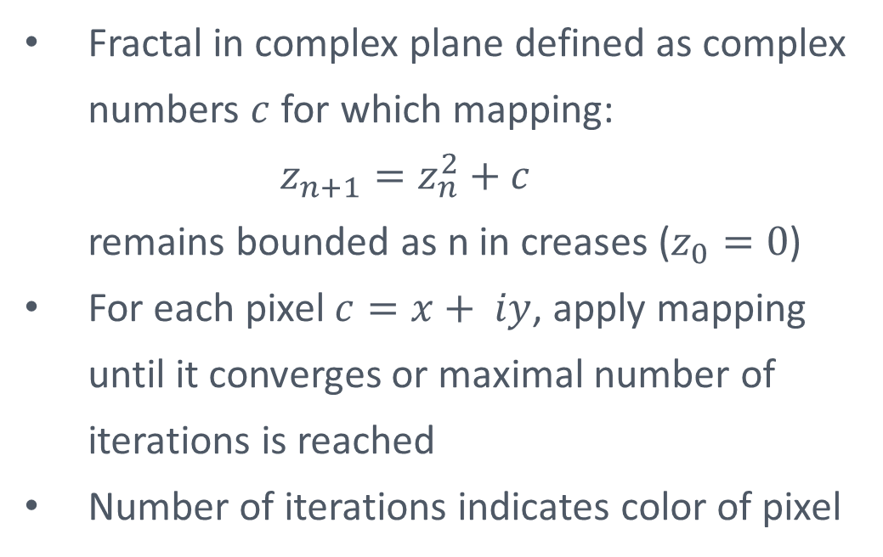
The Mandelbrot set: mathematics
Fractal in complex plane defined as complex numbers $c$ for which mapping: $z_{n+1}=z_{n}^{2}+c$ remains bounded as n in creases ($z_{0}=0$)
For each pixel $c=x+ iy$, apply mapping until it converges or maximal number of iterations is reached
Number of iterations indicates color of pixel

Slide 13
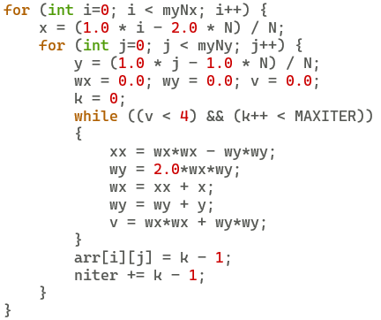
The Mandelbrot set: code
In all example runs, the grid size is 51840 x 34560 (1.8B grid points)

Slide 14
Linaro MAP basics: batch mode
Compile your code with debug symbols (-g1) [Optional: disable inlining]
Load the LinaroForge module, before other modules: module load LinaroForge
Profile your run, inside your job script: map --profile mpirun <your_executable> <options> map --profile python <your_script.py>
Open the generated map file (requires graphical connection): map <your_executable>_<timestamp>.map
[Optional] Launch profiling run interactively from map GUI
[Optional] Run client locally and use remote launch + job submission

Slide 15
Profiling serial CPU code
Top tip 1:
start by optimizing serial performance
Top tip 2: profile a run that is representative for your actual workload

Slide 16
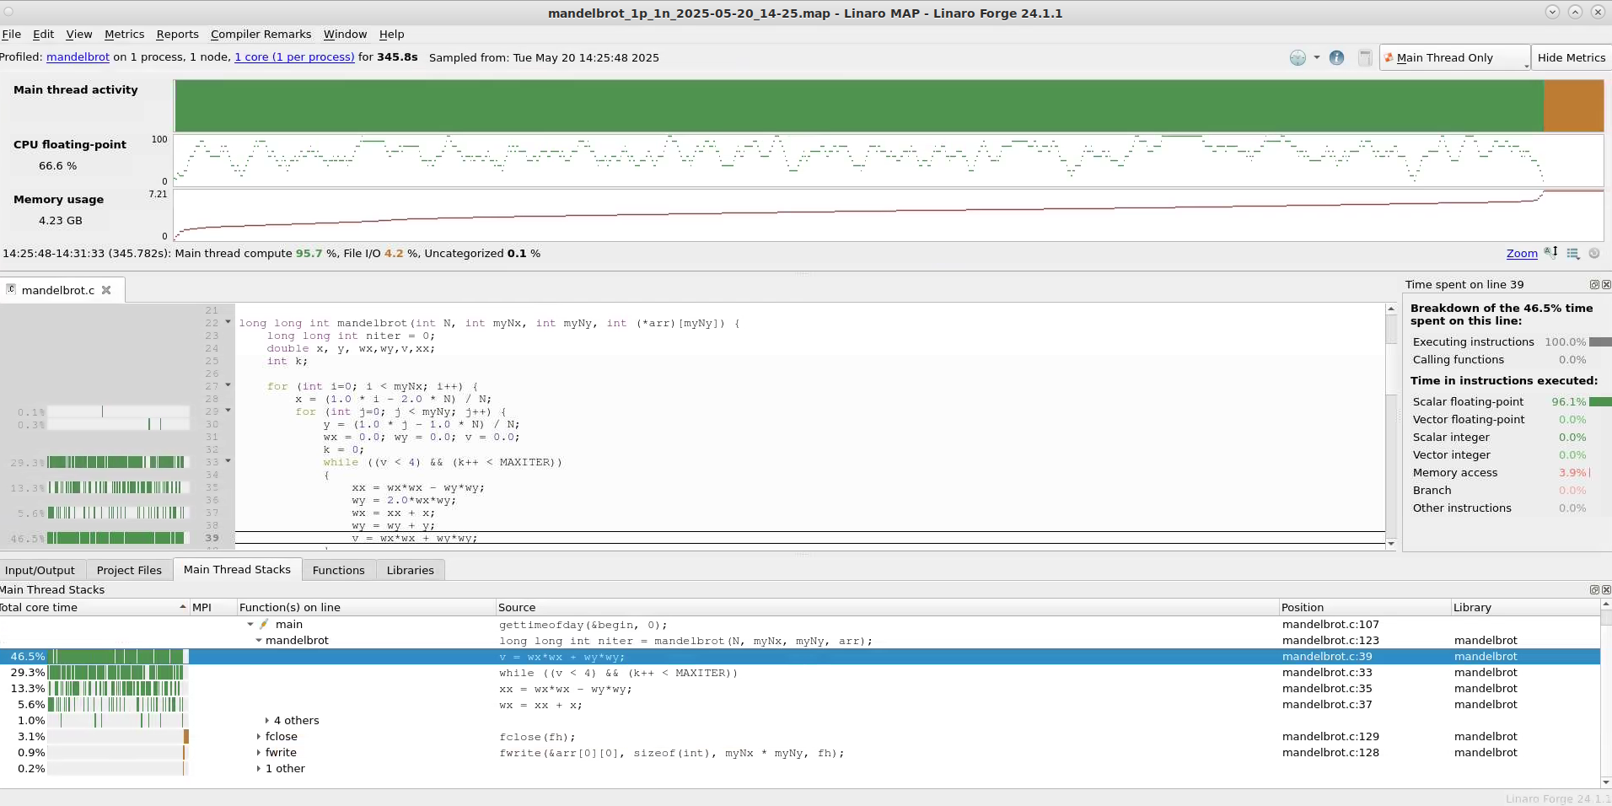
Visualization of the MAP file
Introduction to and overview of profilers
Examples using Linaro MAP
Serial CPU code
MPI parallel CPU code
CUDA GPU code

Slide 17
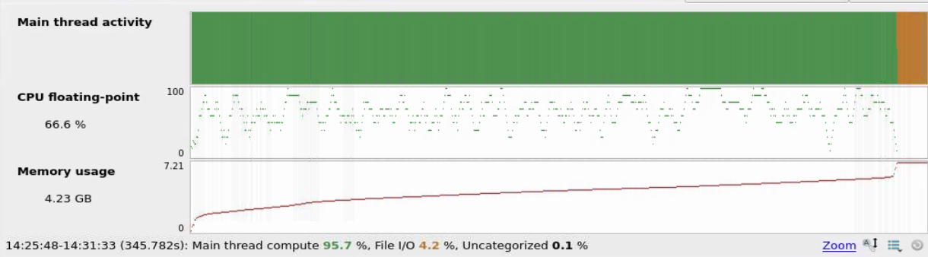
Timeline view
Horizontal axis indicates time
Main thread activity:
vertical axis indicates different processes (single process in this example)
color code: green -> compute – orange -> I/O – blue -> MPI – purple -> accelerator
Other metrics can be chosen from taskbar
Top tip 3: check overhead introduced by profiler
Without profiler: 345s - With profiler: 348s - Difference: <1%
Top tip 4: zoom in on specific phases of the run in the timeline view

Slide 18
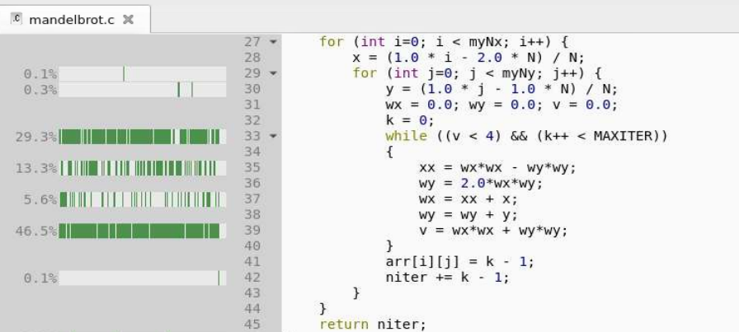
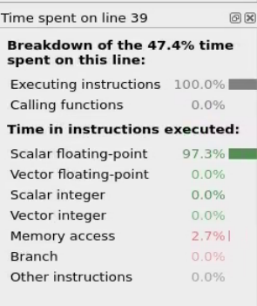
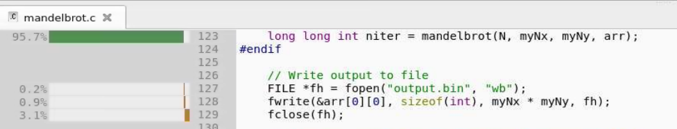
Source code view
Indicates how much time is spent in each line and how it is spent

Slide 19
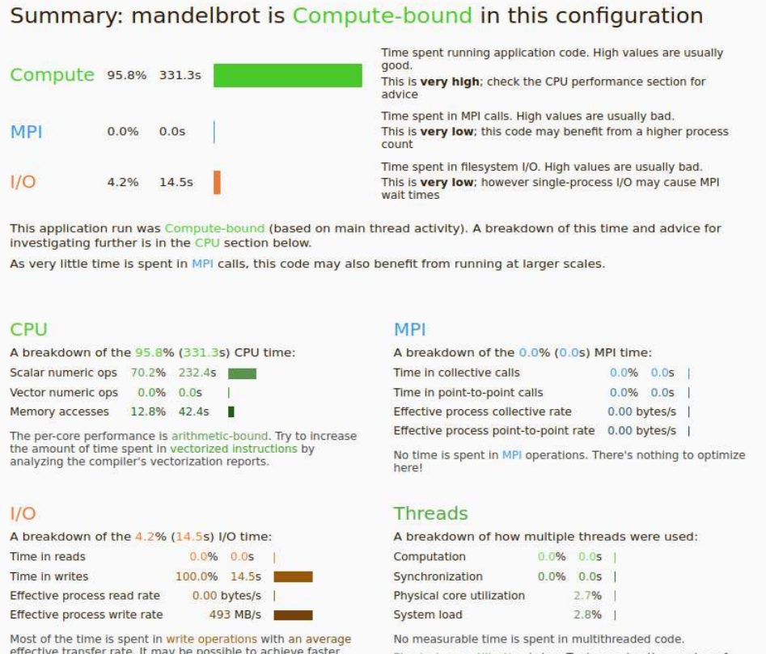
Performance report
Click on “reports” in toolbar to open performance report
Quick glance of performance and suggestions for improvement => recommended as starting point

Slide 20
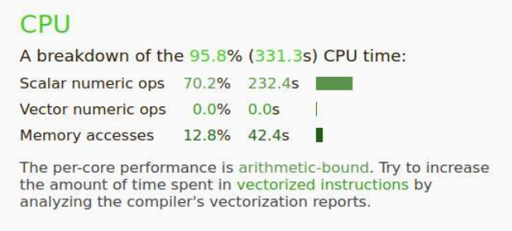
Optimizing serial performance
Top tip 5: focus on sections of the code consuming most resources
Code does not make use of SIMD capabilities
Compiler fails to vectorize loop: $ gcc -fopt-info-vec-missed mandelbrot.c:33:33: missed: couldn't vectorize loop mandelbrot.c:33:33: missed: not vectorized: control flow in loop
Let’s write a version with vector intrinsics ourself!

Slide 21
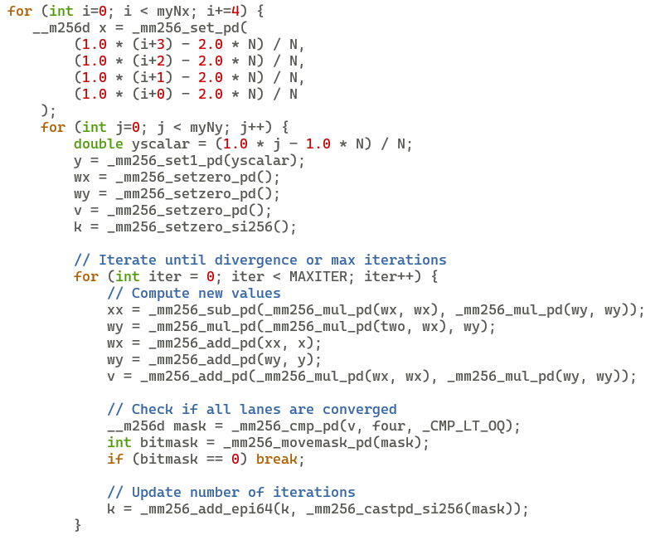
The Mandelbrot set: code with vector instructions

Slide 22
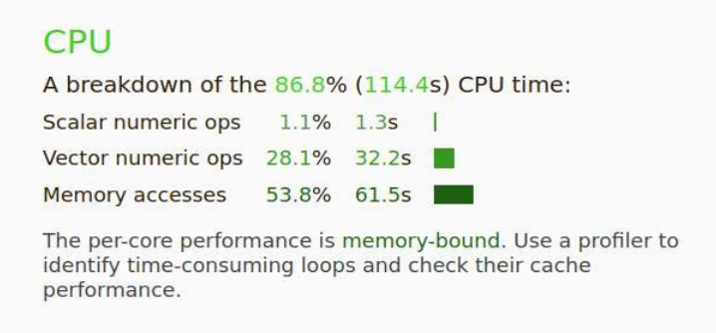
Improved performance with AVX2
Without vectorization
With vectorization
Total runtime decreases from 348s to 128s (2.7x speedup)
AVX2 lanes contain 4 double-precision numbers, but vectorizing loop introduces overhead, so no 4x speedup
Code now becomes memory-bound, might be the next thing to work on

Slide 23
Agenda
Introduction to and overview of profilers
Examples using Linaro MAP
Serial CPU code
MPI parallel CPU code
CUDA GPU code

Slide 24
Parallelization by domain decomposition
Observe that each pixel (xy coordinate) is independent of the others
Divide all pixels over processes and let each process work on its pixels independently => domain decomposition
Does not require a lot of code changes:
Initialize domain decomposition
Re-use existing Mandelbrot code
Dump file with MPI-IO

Slide 25
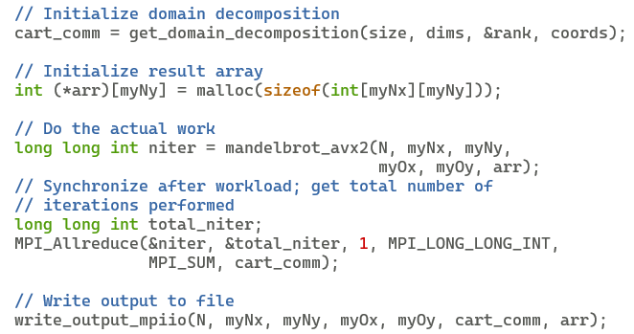
Parallelization by domain decomposition

Slide 26
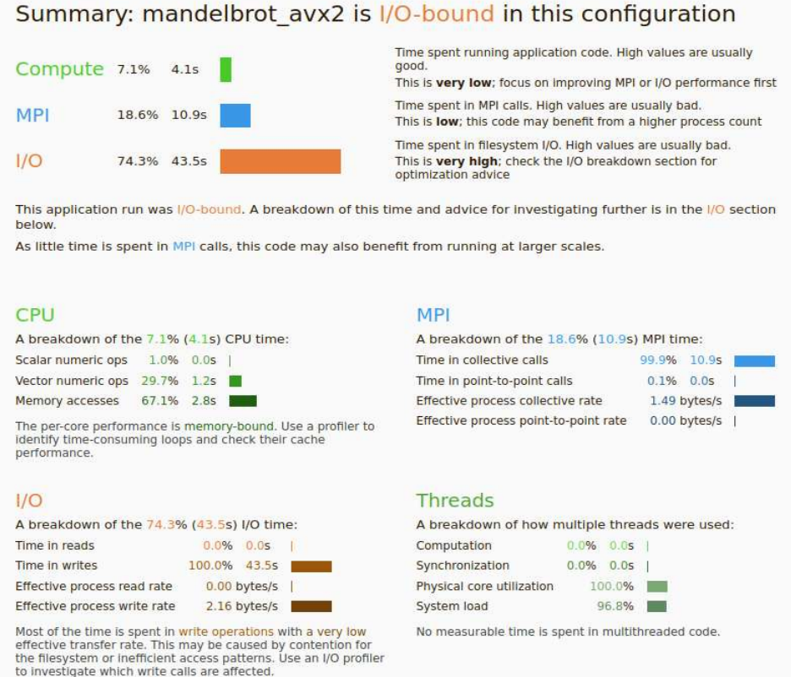
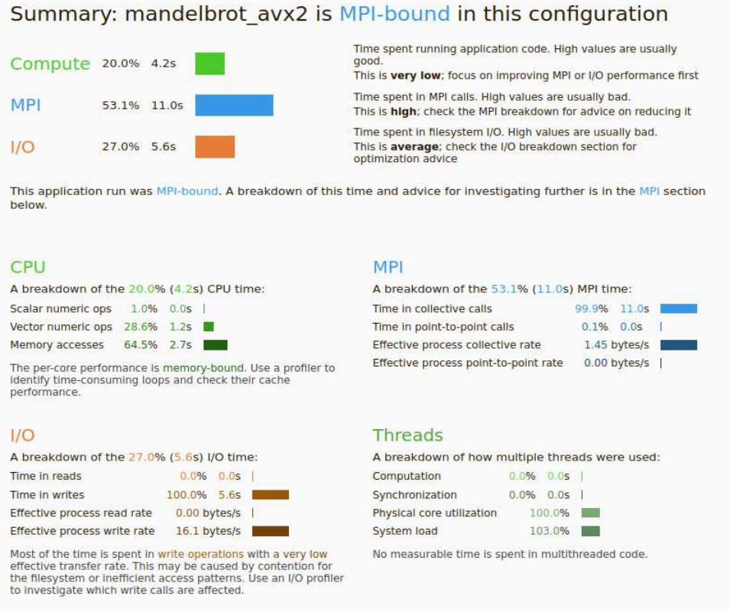
Parallel scaling results: part 1
Serial run takes 128s, parallel run on 36 cores 48s => speedup of only 2.6x, what is going on?
I used ${VSC_DATA} to write output, this is not suited for parallel I/O
Using ${VSC_SCRATCH} instead brings the runtime down to 23s
Code now becomes MPI-bound

Slide 27
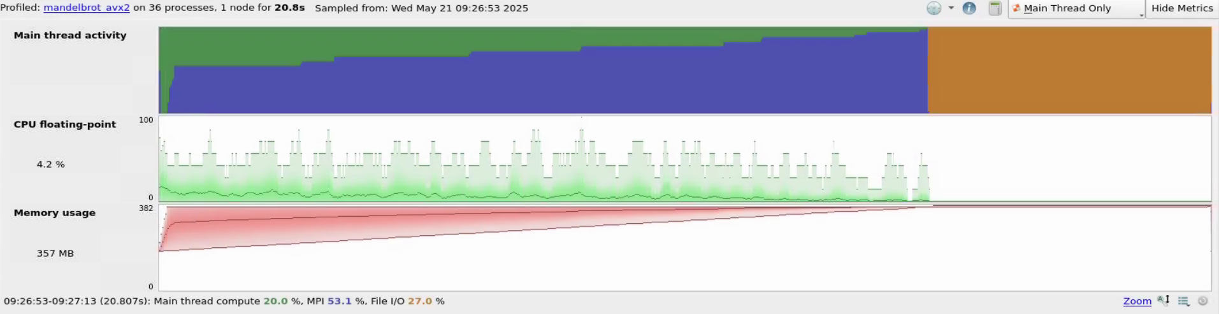
Parallel scaling results: part 2
P35
…
P1
P0
Some processes are spending most time in “compute” (green), other processes are spending most time in “MPI” (blue): => load imbalance
Some processes do more iterations than others

Slide 28
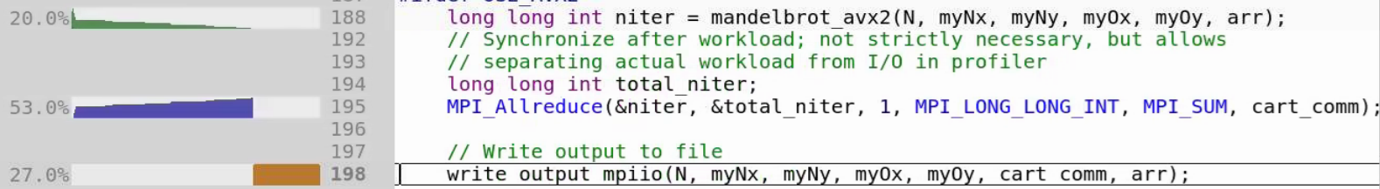
Load imbalance in the source code view
Some processes are spending most time in “compute” (green), other processes are spending most time in “MPI” (blue): => load imbalance
Some processes do more iterations than others

Slide 29
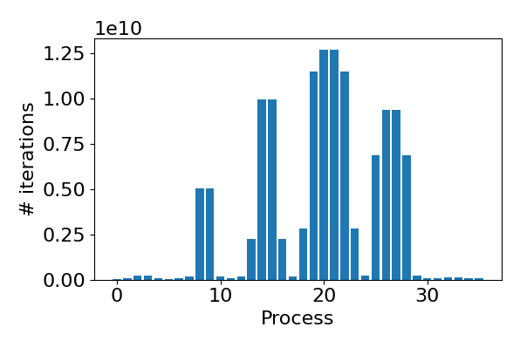
Domain decomposition causes load imbalance
Color indicates number of iterations
Total number of iterations per domain has a high variability: this decomposition has a built-in load imbalance
Possible solution:
Use smaller domains; one process acts as broker to assign domains to processes

Slide 30
Agenda
Introduction to and overview of profilers
Examples using Linaro MAP
Serial CPU code
MPI parallel CPU code
CUDA GPU code

Slide 31
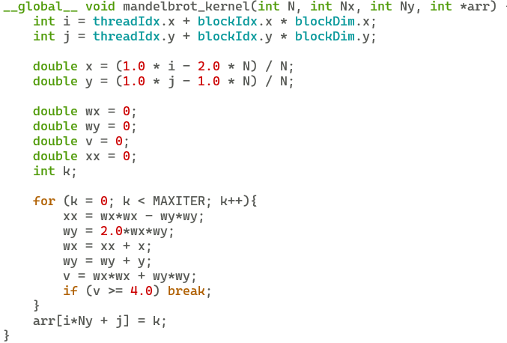
The Mandelbrot set in CUDA
CUDA kernel code looks quite similar to C code

Slide 32
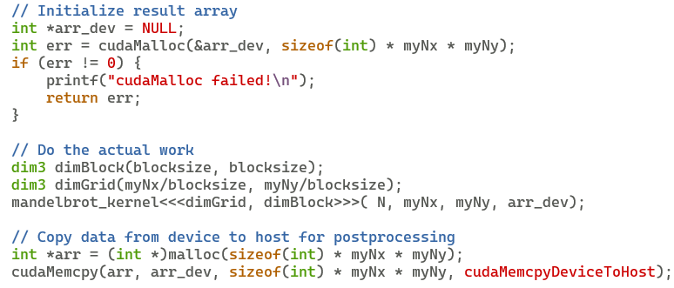
The Mandelbrot set in CUDA
Allocate result array on GPU
Launch kernel
Copy back results before writing file

Slide 33
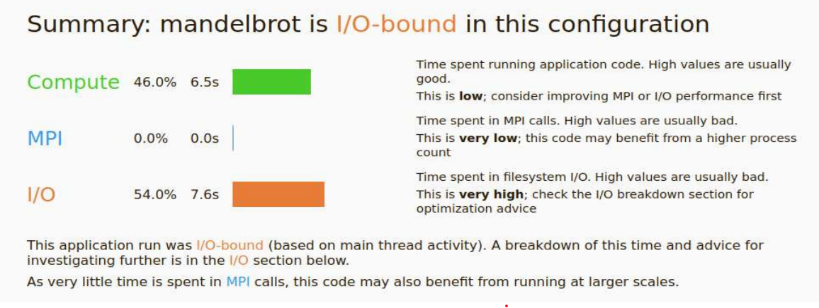
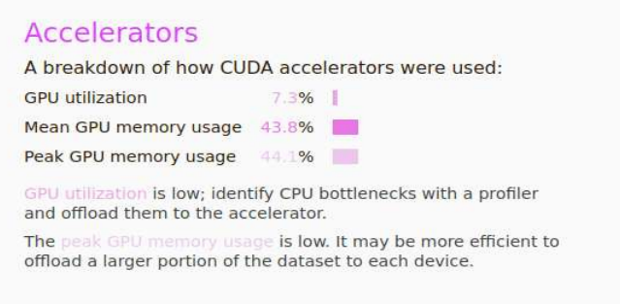
CUDA performance report
Code becomes I/O bound again
GPU is so fast at “compute” portion, the GPU utilization is low
This particular code is probably not very well suited for GPU…

Slide 34
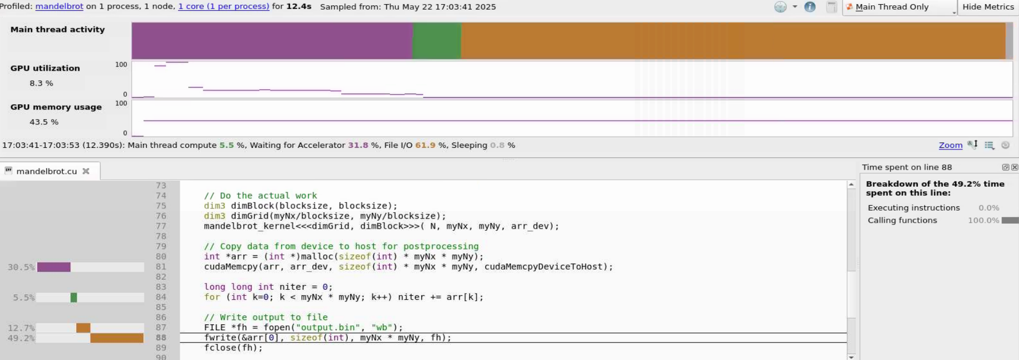
CUDA timeline view
Actual compute region
Top tip 6: explore metrics presets (such as NVIDIA) to improve the timeline view
Top tip 7: consider using specialized profiler (NVIDIA Nsight) for NVIDIA GPU runs
Kernel is launched asynchronously => does not show up in code view
Most time is spent transferring data from GPU to CPU and from CPU to file

Slide 35
Conclusions
Using a profiler gives insight into performance of your code
Many profilers suited for HPC to choose from, combining tools can be a good idea
LinaroForge MAP is a good starting point, main limitation is the number of license tokens
Code examples are available at https://github.com/hpcleuven/code-profiling-workshop
This presentation was inspired by https://gjbex.github.io/Code-optimization/ => recommended to learn about code optimization (next run in 2026) => keep an eye on https://www.vscentrum.be/vsctraining

